Slide 2
Sentiment Analysis
Submitted to:
Department of Computer Science and Engineering

Slide 3
Supervised by: Prof. Shraddha Sharma
Team Members
1. Gourav Sharma (0827CS201083)
2. Harsh Dad (0827CS201089)
3. Harsh Jaiswal (0827CS201091)
4. Ishani Pandey (0827CS2011013)

Slide 4
Project Presentation Outline
Abstract
Introduction
Problem Statement
Survey of Existing Systems
Project Objectives
Project Description
Planning of Project
The Outcome Discussion & ScreenShot
Conclusions

Slide 5

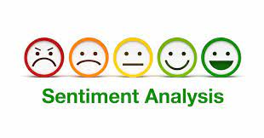
Abstract
Analyze user-generated content, such as comments or posts, to determine the sentiment of the content. This can help social networks identify negative or harmful content and take action to remove it.

Slide 6

Introduction
Sentiment analysis, also known as opinion mining, is the process of extracting subjective information from text data and determining the sentiment expressed within it. This project aims to develop an efficient sentiment analysis model that can analyze large volumes of textual data and classify it into positive, negative, or neutral sentiments. The project utilizes advanced natural language processing (NLP) techniques and machine learning algorithms to achieve accurate sentiment classification.

Slide 7
Problem Statement
The proliferation of user-generated content on social networks has given rise to the urgent need for efficient sentiment analysis tools. These tools must accurately assess the sentiment of comments and posts to help identify negative or harmful content. However, the challenge lies in developing robust algorithms and models that can reliably distinguish between positive, neutral, and negative sentiments in a wide range of languages and contexts.
Additionally, ensuring a balance between freedom of expression and the removal of harmful content poses a significant ethical and technical challenge. This problem statement seeks to address the development of advanced sentiment analysis solutions to assist social networks in maintaining a safe and positive online environment for their users.

Slide 8
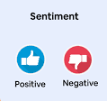
Survey of Existing Systems
Problems Addressed
IBM Watson Natural Language Understanding: IBM Watson offers the Natural Language Understanding (NLU) service, which provides sentiment analysis as one of its features. NLU utilizes machine learning models to analyze sentiment in text data. It is available as a cloud-based service and provides APIs for easy integrationintoa applications.
Advantages
Multilingual Support.
Cloud-Based Service.
Natural Language Understanding Capabilities.
Disadvantages
Cost
Dependency on IBM Infrastructure
Language and Cultural Bias
Gaps Identified
Contextual Understanding.
Domain-Specific Sentiment.
Reference link
https://www.ibm.com/products/natural-language-understanding

Slide 9

Survey of Existing Systems
Problems Addressed
Aylien: Aylien offers sentiment analysis software that provides text classification and sentiment analysis capabilities. It includes features like document-level sentiment analysis, entity-level sentiment, and aspectbased sentiment analysis. Aylien's sentiment analysis software can be used through their API or integrated into custom applications.
Advantages
1.Industry-Specific Sentiment Analysis.
2.Emotion Analysis.
Disadvantages
1. Language Support and Accuracy.
2. Interpretation of Neutral Sentiment.
Gaps Identified
1.Handling of Complex Sentence Structures
Reference link
1. https://aylien.com/product/news-api

Slide 10
Objectives
Preprocess the textual data by removing noise, handling punctuation, and converting it into a suitable format for analysis.
Explore various feature extraction techniques to represent the text data effectively.
Implement and train different machine learning models, such as Naive Bayes, Support
Vector Machines (SVM), and Recurrent Neural Networks (RNN), for sentiment classification.
Evaluate the performance of the model’s using metrics like accuracy, precision, recall, and F1-score.
Fine-tune the models and optimize their hyperparameters to improve their performance

Slide 11
Project Description
Preprocess the textual data by removing noise, handling punctuation, and converting it into a suitable format for analysis. Explore various feature extraction techniques to represent the text data effectively. Implement and train different machine learning models, such as Naive Bayes, Support Vector Machines (SVM), and Recurrent Neural Networks (RNN), for sentiment classification. Evaluate the performance of the model’s using metrics like accuracy, precision, recall, and F1-score. Fine-tune the models and optimize their hyperparameters to improve their performance

Slide 12
Methodology/Planning of the Project work
Data Collection: Gather a diverse collection of textual data from various sources, such as social media platforms, product reviews, and news articles, to build a comprehensive sentiment analysis dataset.
Data Preprocessing: Clean the collected data by removing irrelevant information, handling special characters, and converting text to lowercase. Apply techniques like tokenization, stop word removal, and stemming/lemmatization to further refine the data.
Feature Extraction: Utilize techniques such as Bag-of-Words (BoW), Term FrequencyInverse Document Frequency (TF-IDF), and word embeddings (e.g., Word2Vec, GloVe) to represent the textual data as numerical features suitable for machine learning models.
Model Development: Implement and train multiple machines learning models, including Naive Bayes, SVM, and RNNs, using the preprocessed data and extracted features. Tune the models' hyperparameters to achieve optimal performance.
Model Evaluation: Assess the performance of the trained models using various evaluation metrics, comparing their accuracy, precision, recall, and F1-score. Perform cross-validation and statistical analysis to validate the results.
Model Optimization: Fine-tune the best-performing models by adjusting hyperparameters, applying regularization techniques, and exploring ensemble methods to improve their sentiment classification accuracy.

Slide 13
Expected Outcome
Development of a comprehensive sentiment analysis dataset suitable for training and evaluation purposes.
Implementation and evaluation of various machine learning models for sentiment classification.
Identification of the most effective feature extraction techniques for sentiment analysis.
Optimization of the sentiment analysis models to achieve higher accuracy and performance.
Deployment of a user-friendly web application for real-time sentiment analysis..

Slide 14
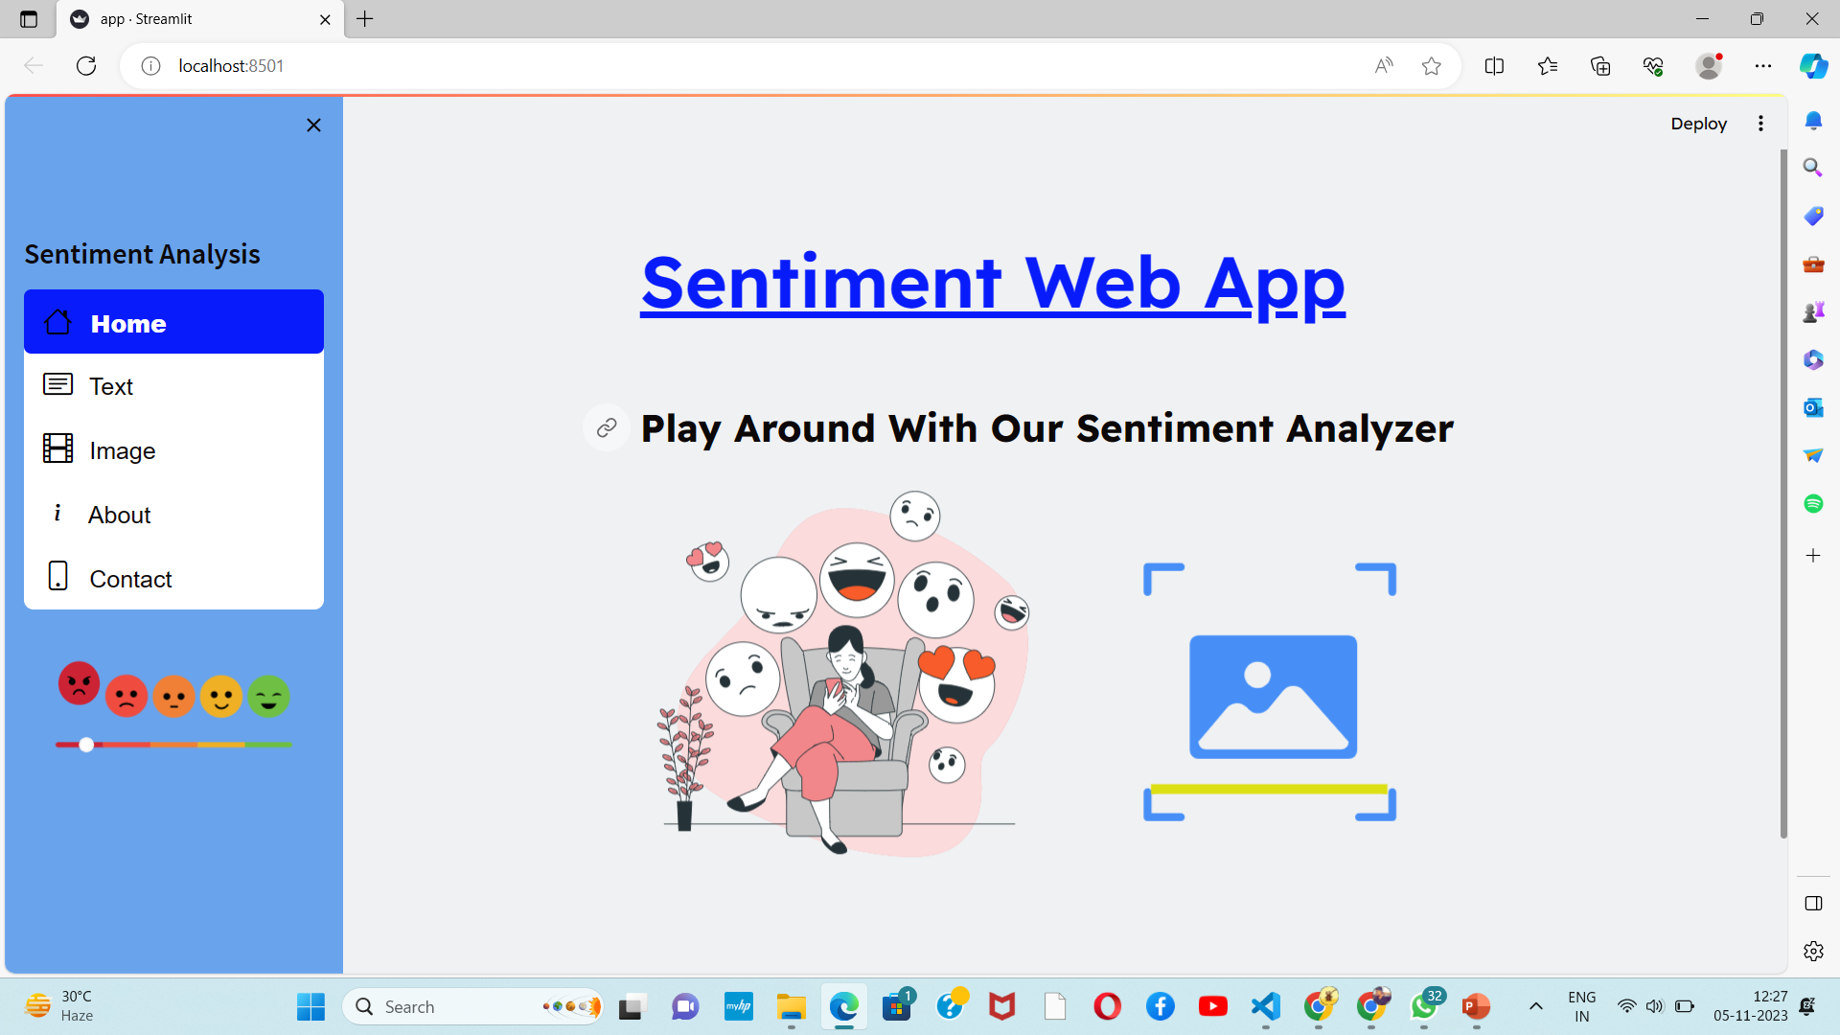
Screen-Shot

Slide 15
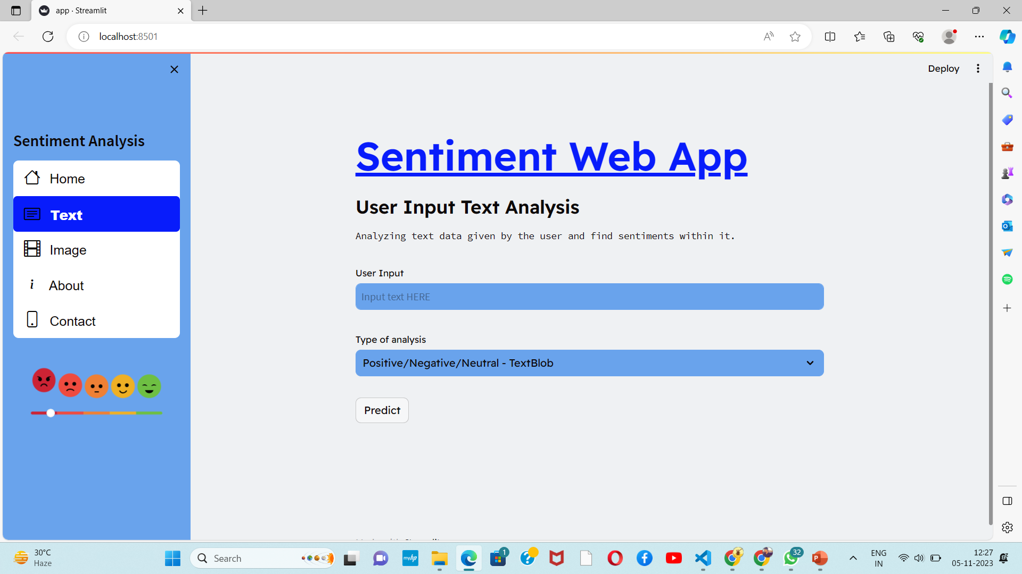
Screen-Shot

Slide 16
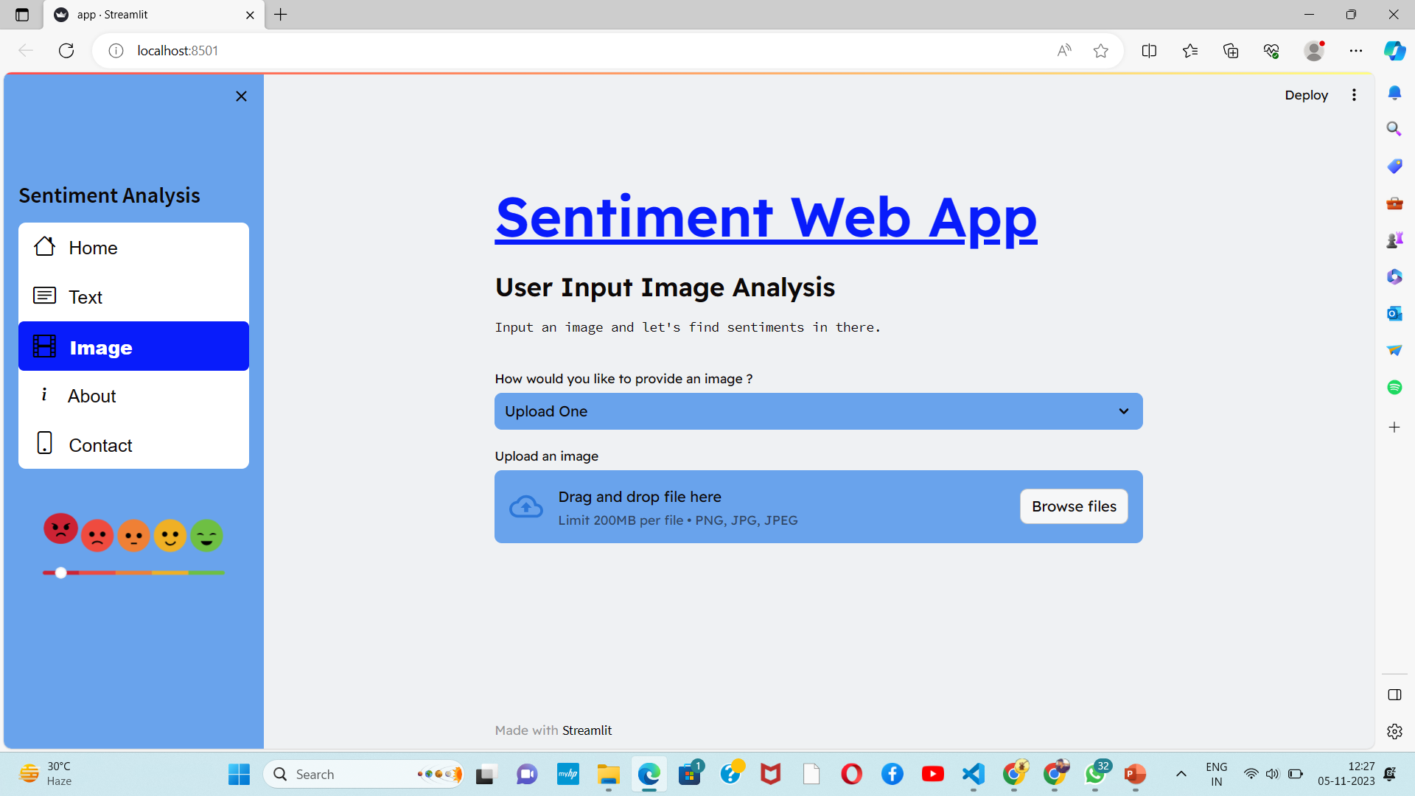
Screen-Shot

Slide 17
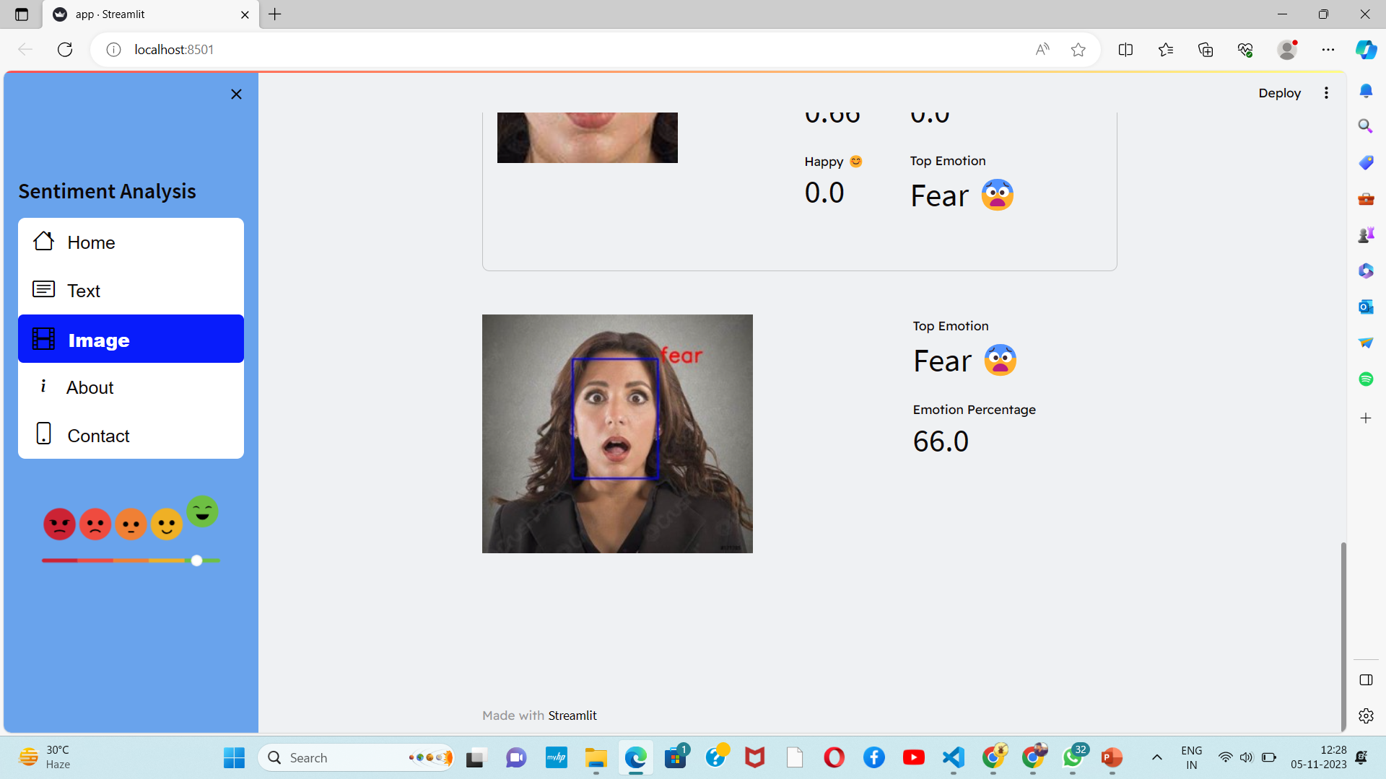
Screen-Shot

Slide 18
Screen-Shot

Slide 19
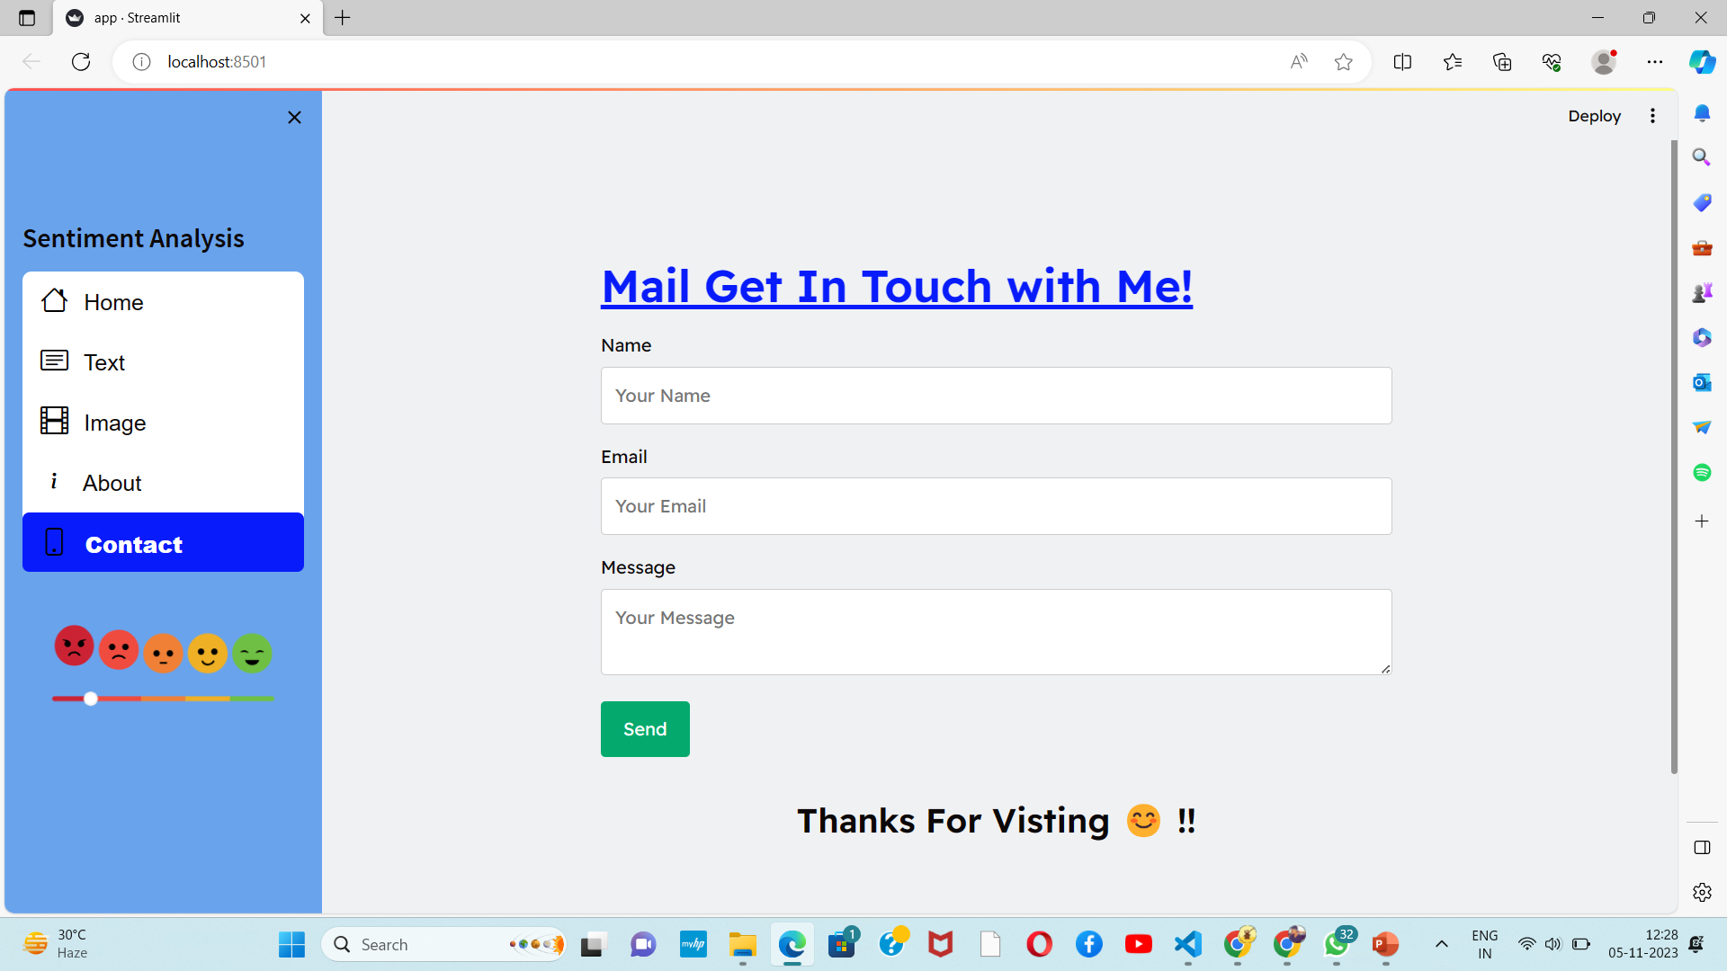
Screen-Shot

Slide 20
Conclusion
Sentiment analysis plays a crucial role in understanding public opinion, customer feedback, and social media sentiment. This project aims to develop an efficient sentiment analysis system capable of accurately classifying textual data into positive, negative, or neutral sentiments. By leveraging advanced NLP techniques and machine learning algorithms, the project aims to provide valuable insights and actionable information to businesses, researchers, and decisionmakers. The deployed web application will enable real-time sentiment analysis, empowering users to gauge public sentiment on various topics and make informed decisions based on the analyzed data.

Slide 21
Q&A

Slide 22
THANKS

